Slide 1
Bank Marketing Campaign
Praneetha Rajupalepu
Selaelo Ramokgopa
Surya Chandra
07/03/2022

Slide 2
Background
•ABC Bank wants to sell it's term deposit product to customers and before launching the product they want to develop a model which help them in understanding whether a particular customer will buy their product or not (based on customer's past interaction with bank or other Financial Institution).
•Objective: ABC Bank wants to use ML model to shortlist customer whose chances of buying the product is more so that their marketing channel (tele marketing, SMS/email marketing etc) can focus only to those customers whose chances of buying the product is more.
The analysis will provide information about the following:
•Business and Data Understanding
•Data Acquisition & Preparation
•Modelling
•Deployment

Slide 3
Business Understanding
The plan is to help ABC company to provide a short list of customer that are more likely to buy their product based on their bank details information such as loan.
Marital status, account balance etc.
This goal will be achievable by using a sophisticated machine learning algorithm capable of using a customer record to predict their future action in a blink of an eye to reduce the company’s time and resources.
The success criteria:
The business problem would be based on how much maximum number of customers we are able to predict who have subscribed to the product

Slide 4
Data Exploration
Tabular data details:
Total number of observations 41188.
Total number of files 1.
Base format of the file .csv Size of the data 4.81 MB.
Approaches:
Data looks pretty clean and we have unbalanced classes for our target and outliers.
Categorical imbalance is reduced by eliminating unknown values and also replacing them with mean.
The dataset is heavily skewed. We looked at a few of the numeric features, and the ones that are skewed will need to be transformed.
Techniques like IQR score and Weight of Evidence(WOE) and Information Value(IV) are used to deal with outliers and skewness in the data.

Slide 5
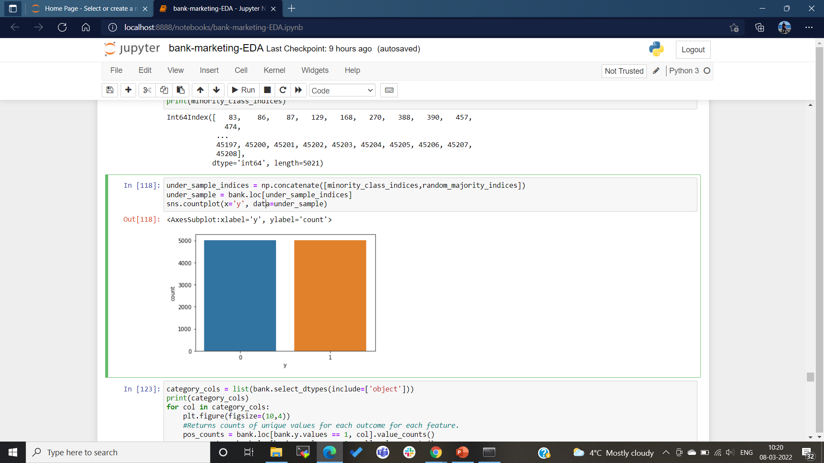
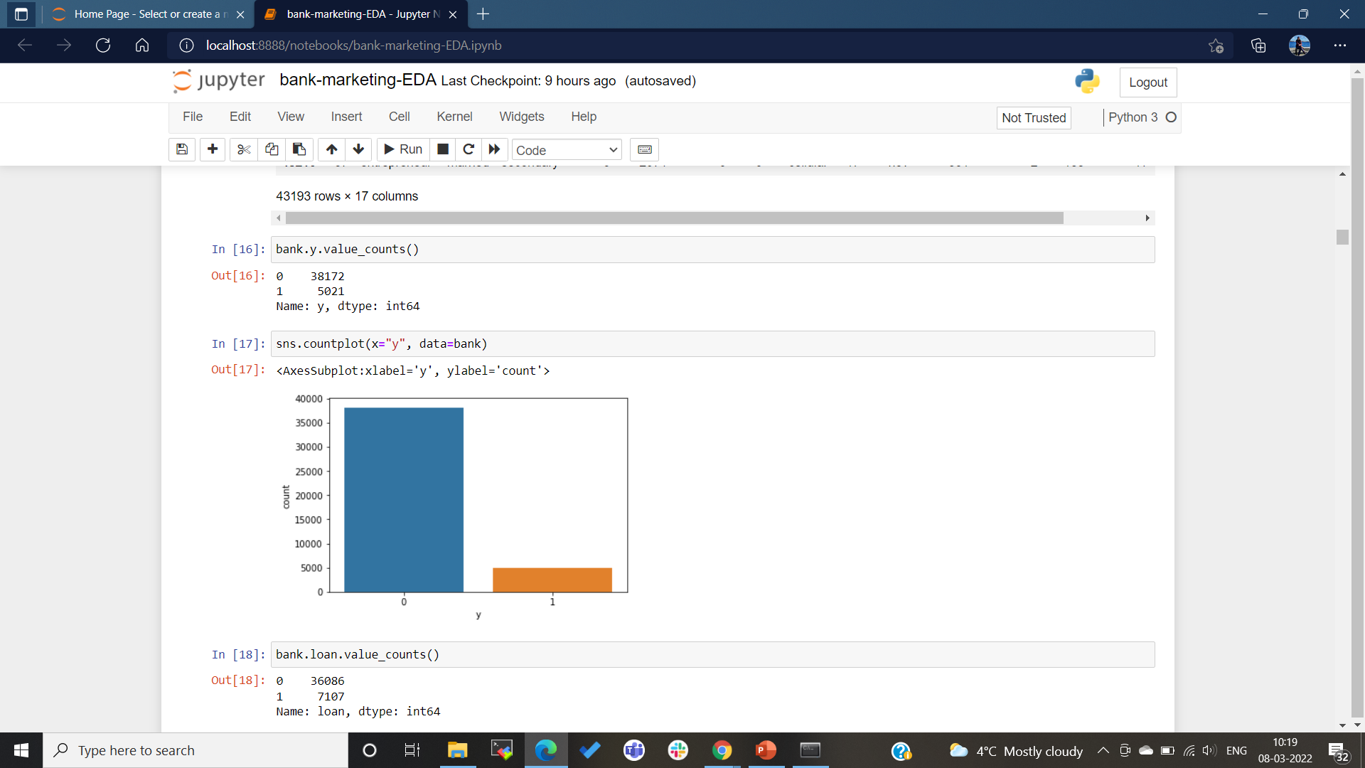
Handling Imbalance Target Data
Target column→ Term Deposit subscription (y) is imbalanced.
Minority class length: 5021 and Majority class length: 38172
Imbalance is handled using Under sampling technique.

Slide 6
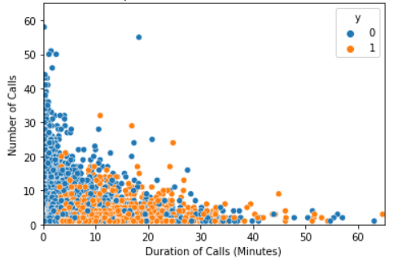
Data Understanding
The Relationship between the Number and Duration of Calls:
According to graph:
Duration and number of calls
depends on term subscription:
Less duration with no subscription
10-20 mins range duration with
minimal calls with subscription-based
customers.

Slide 7
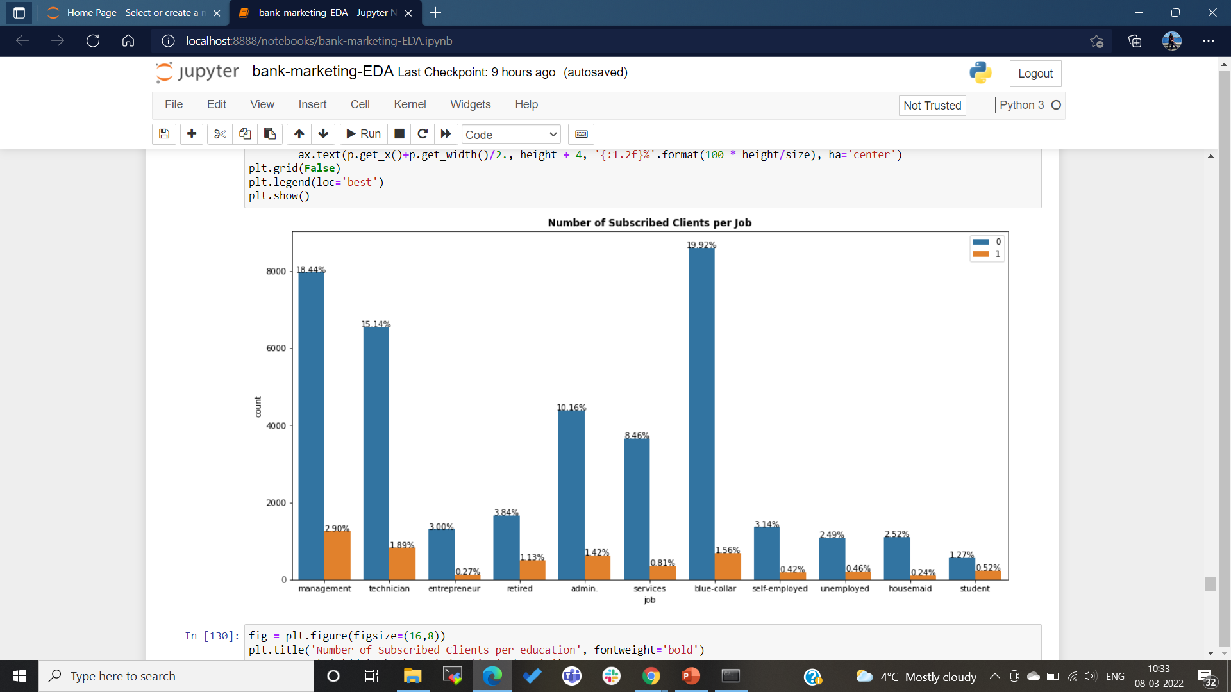
Client subscriptions vs Job

Slide 8
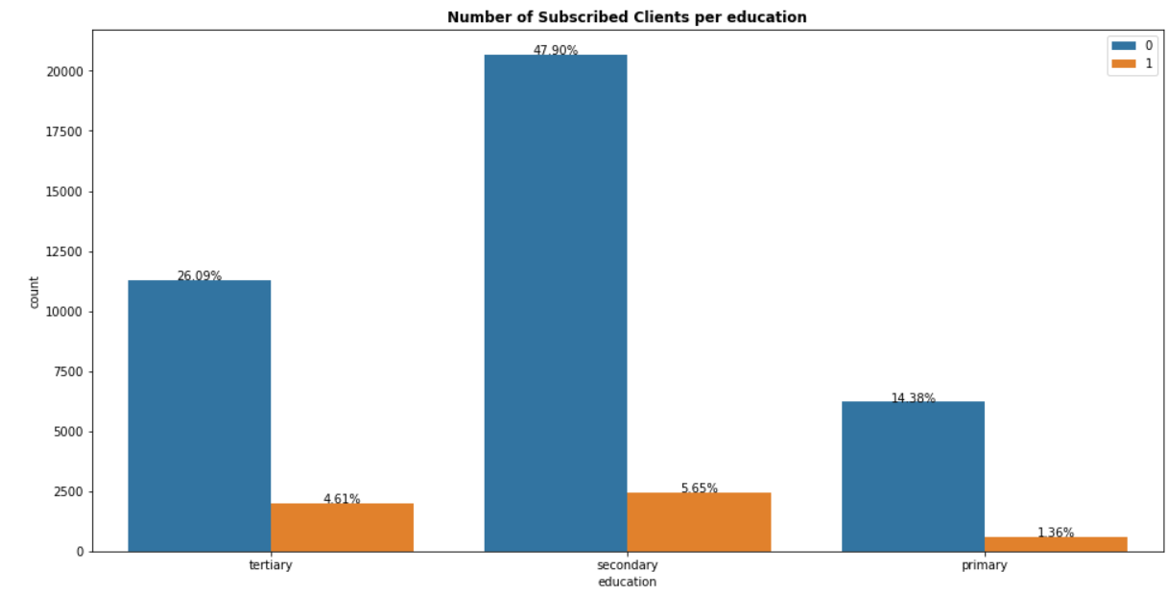
Client subscription vs Education

Slide 9
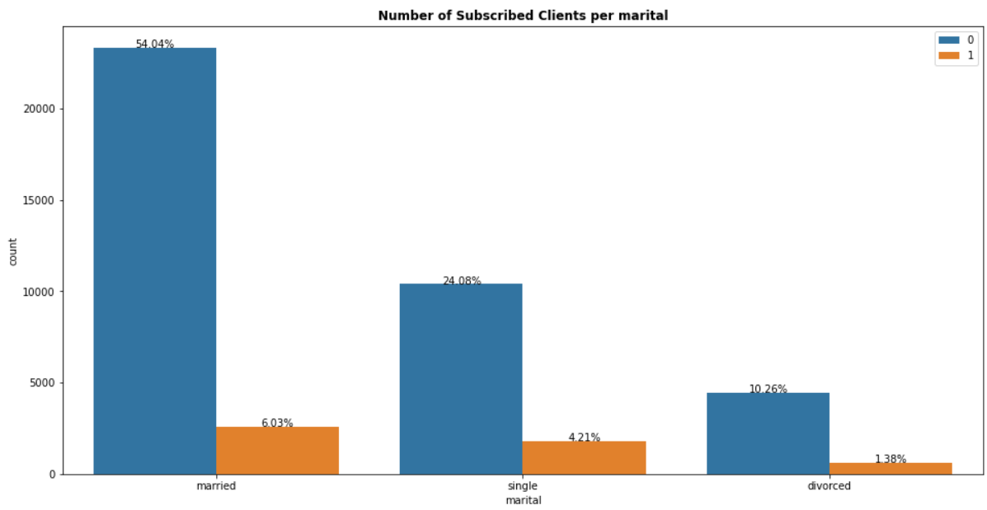
Client subscription vs Marital Status

Slide 10
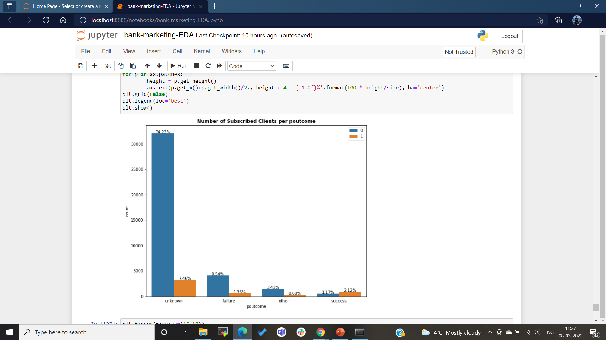
Client subscriptions vs poutcome

Slide 11
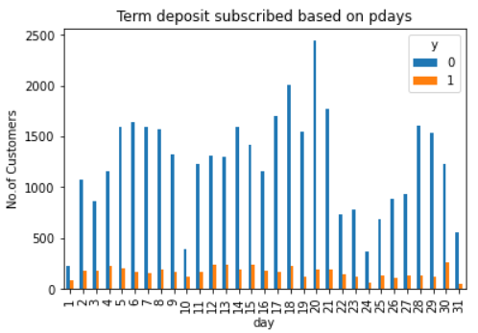
Client subscriptions vs days

Slide 12
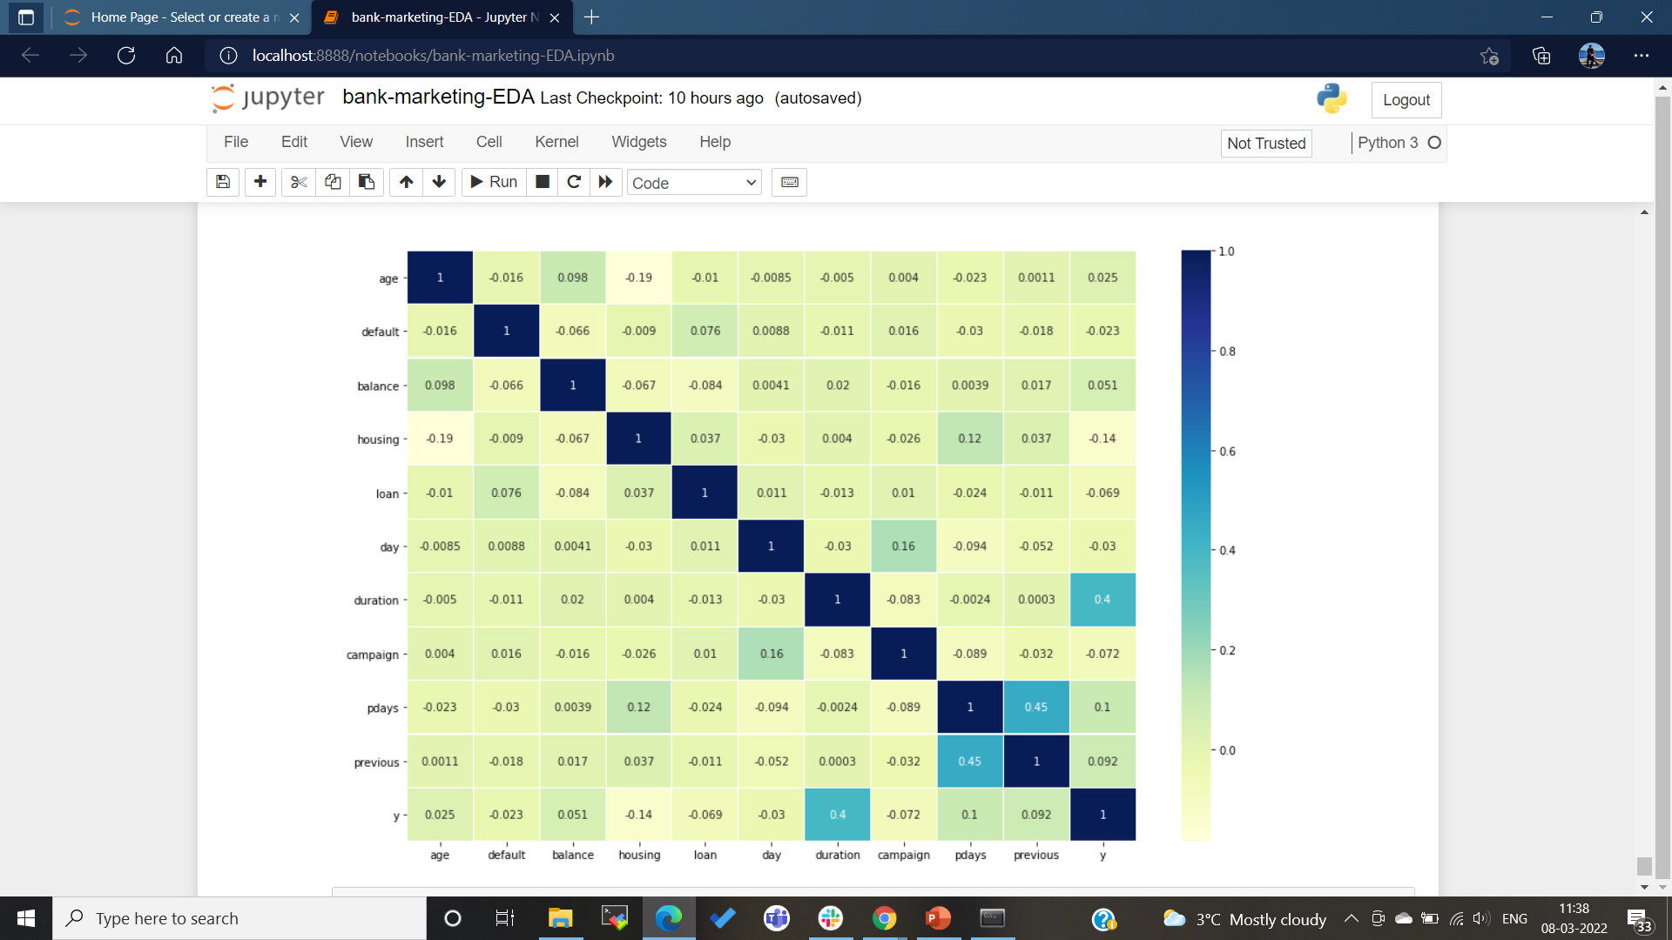
Correlation Map of Data

Slide 13
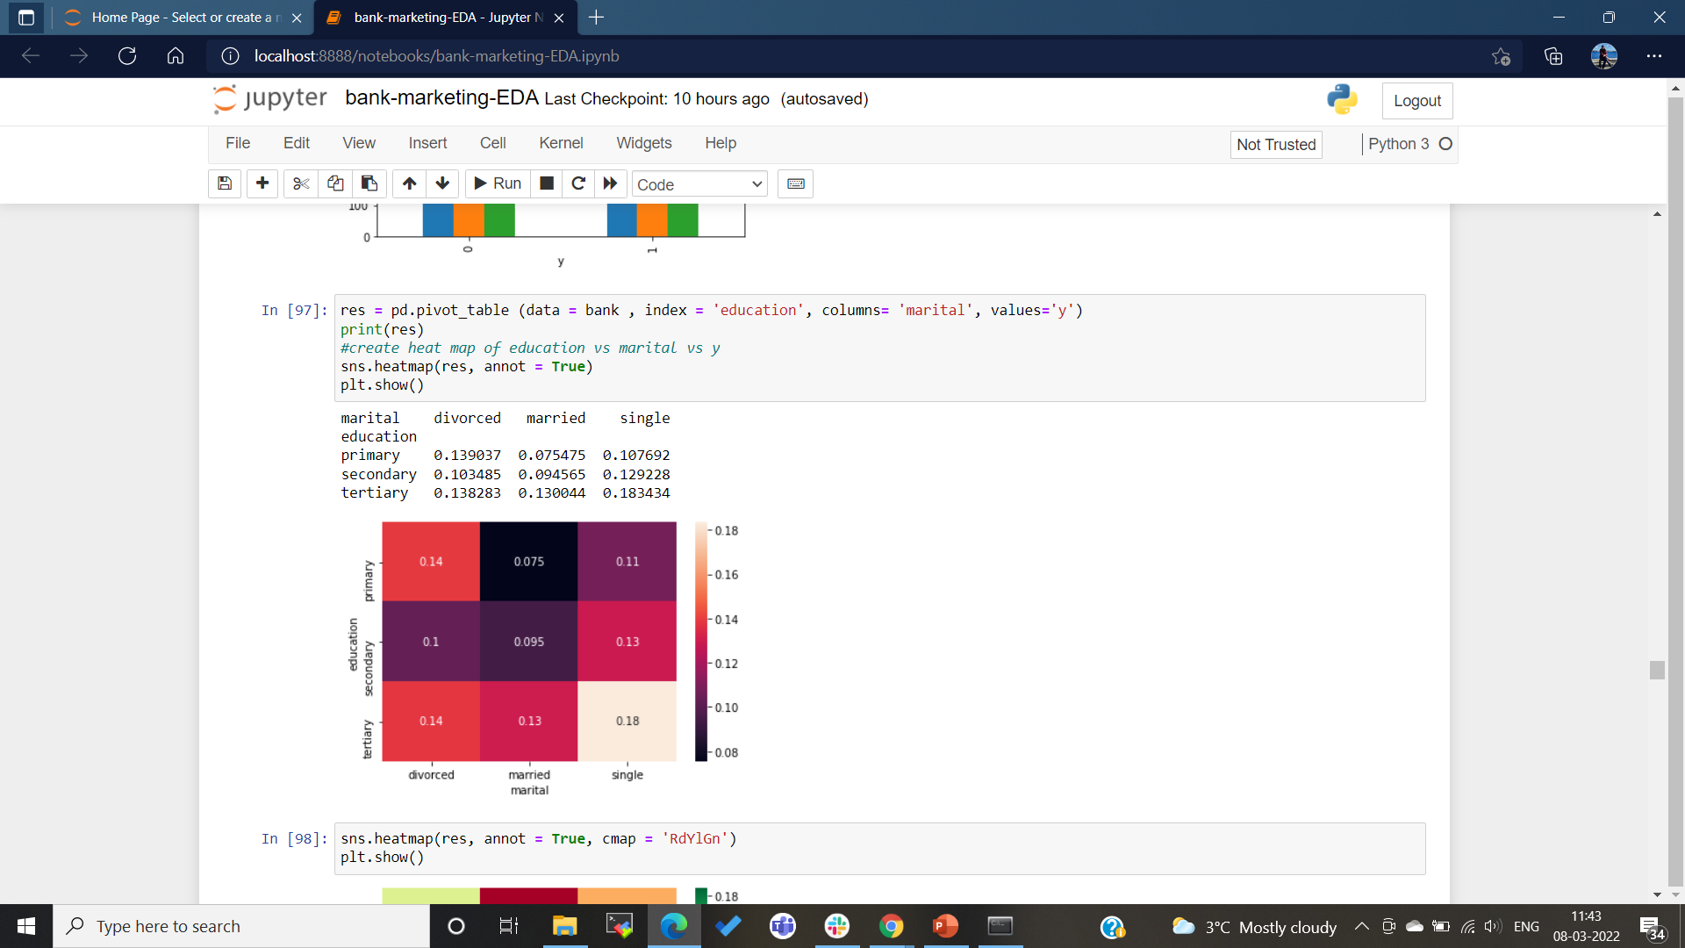
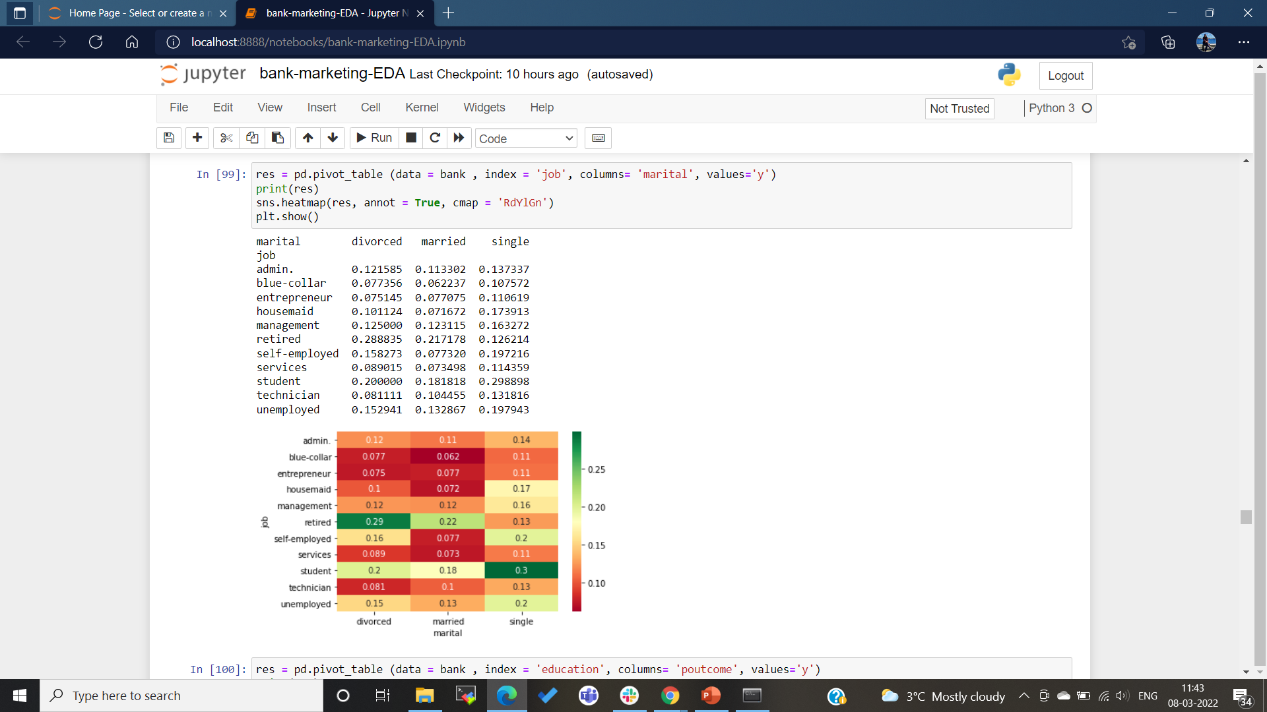
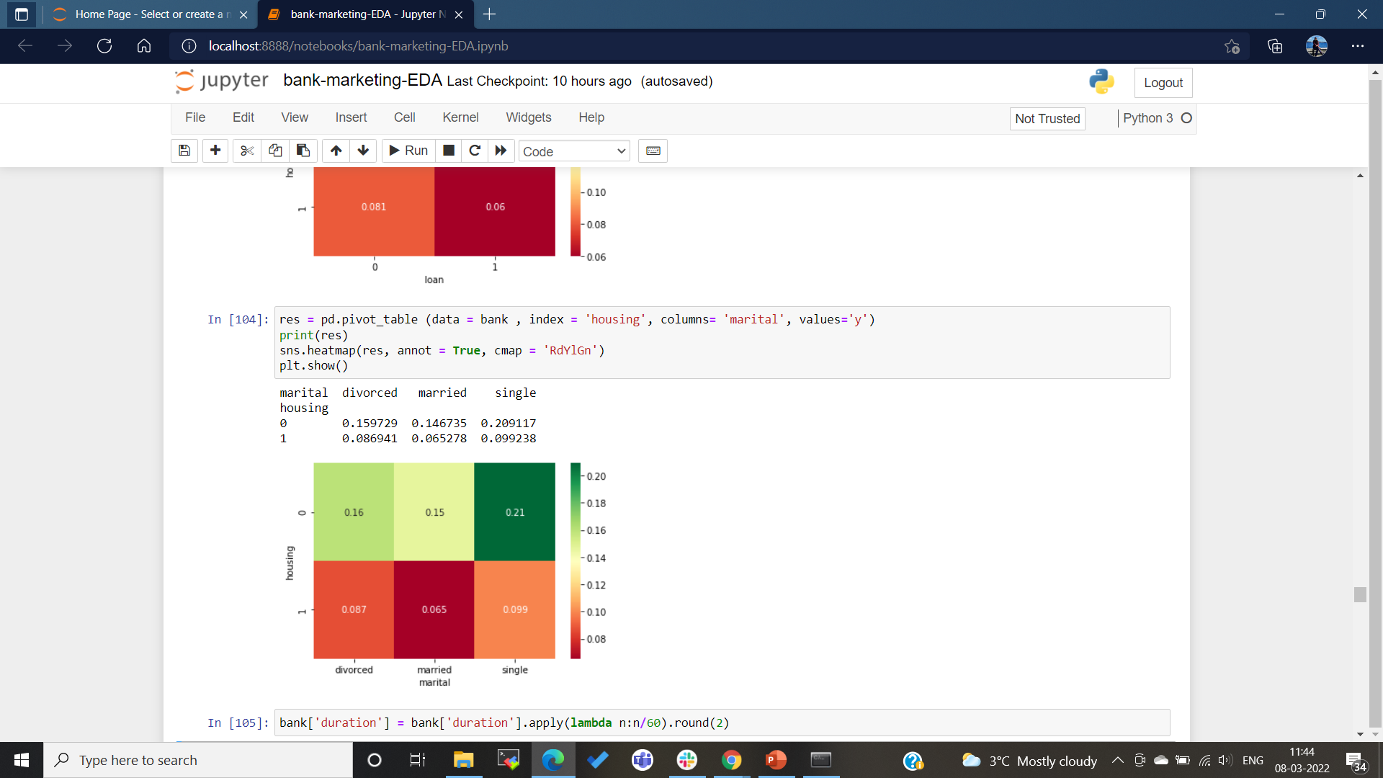
Pivot Tables representation of client subscriptions between marital status and {education, housing, job}:

Slide 14
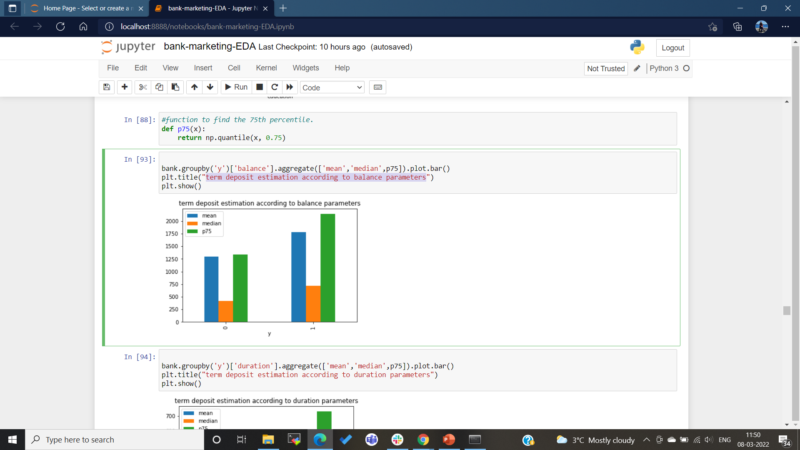
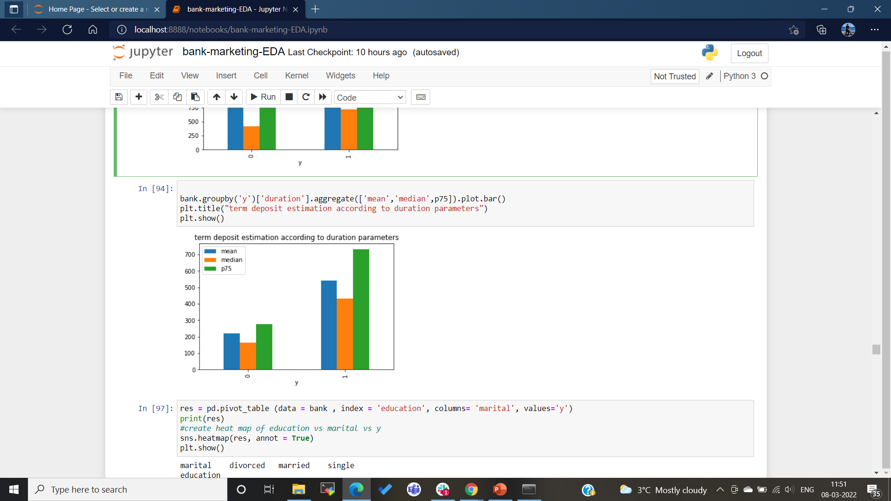
Term deposit estimation according to balance and duration parameters:

Slide 15
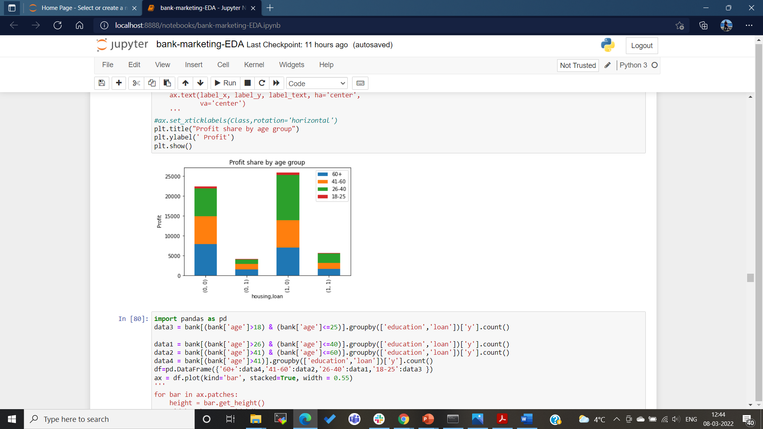
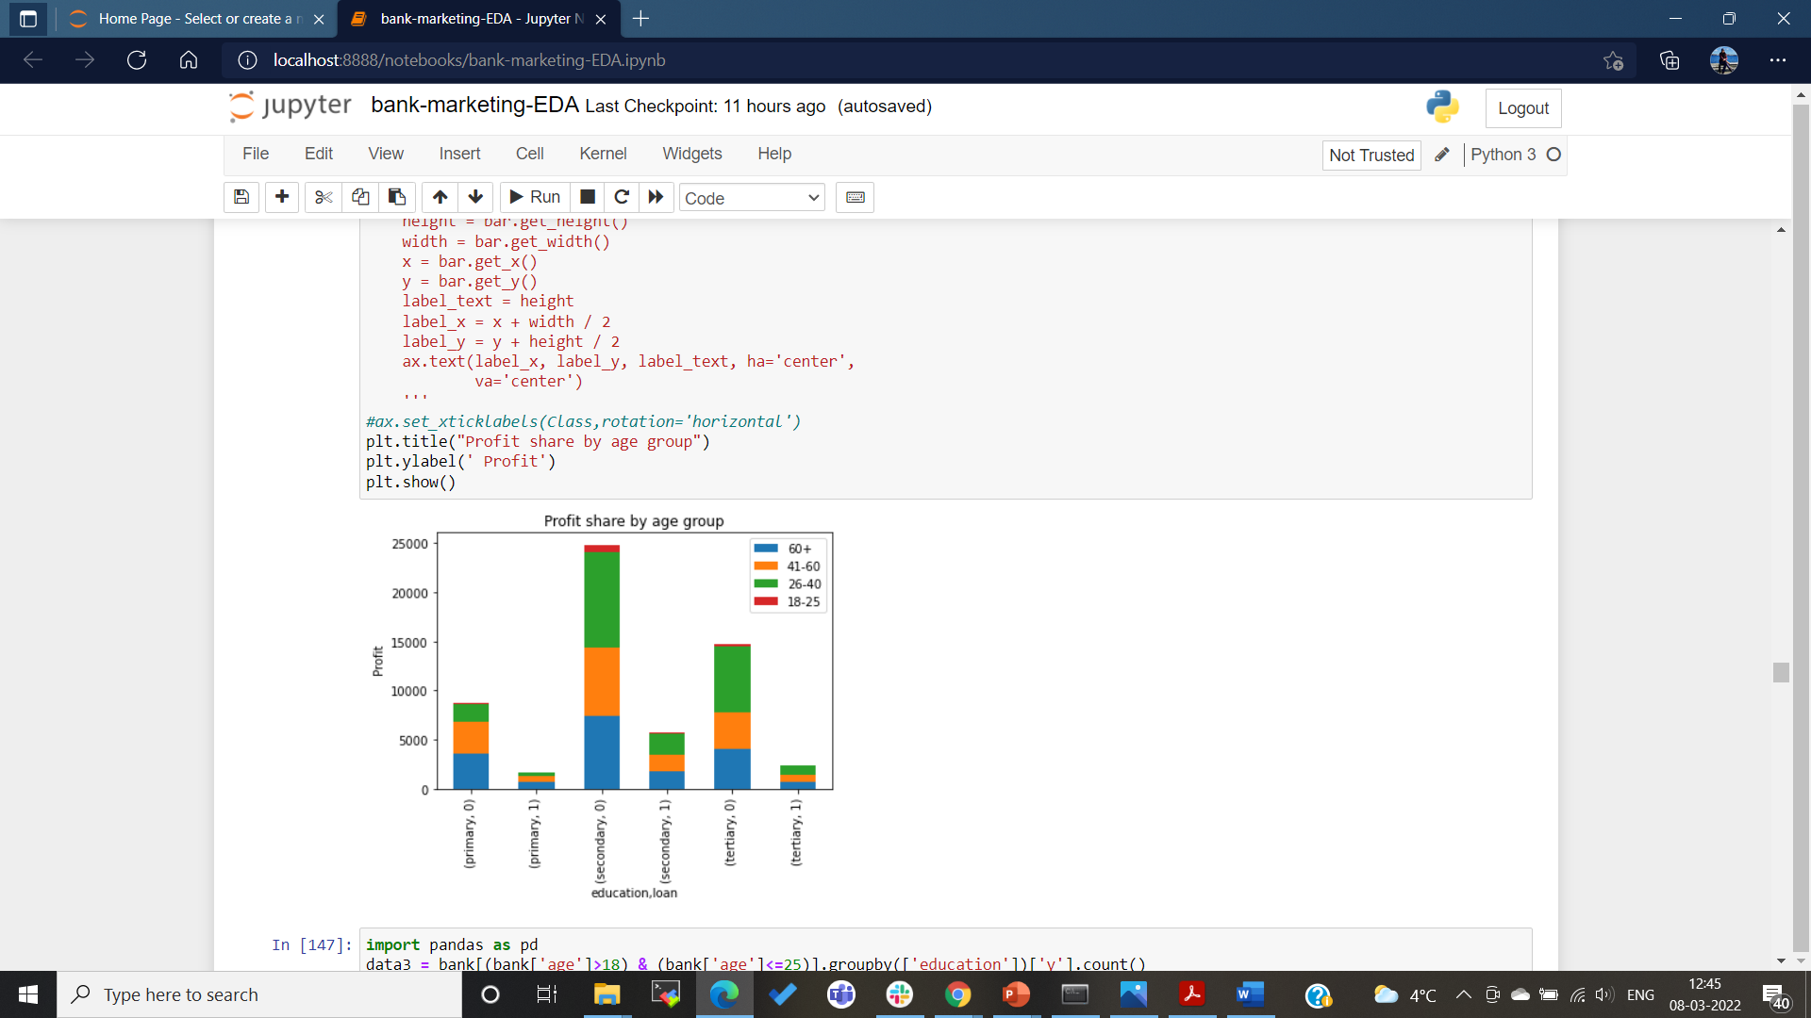
Profit shares by age groups in housing, loan, and education

Slide 16
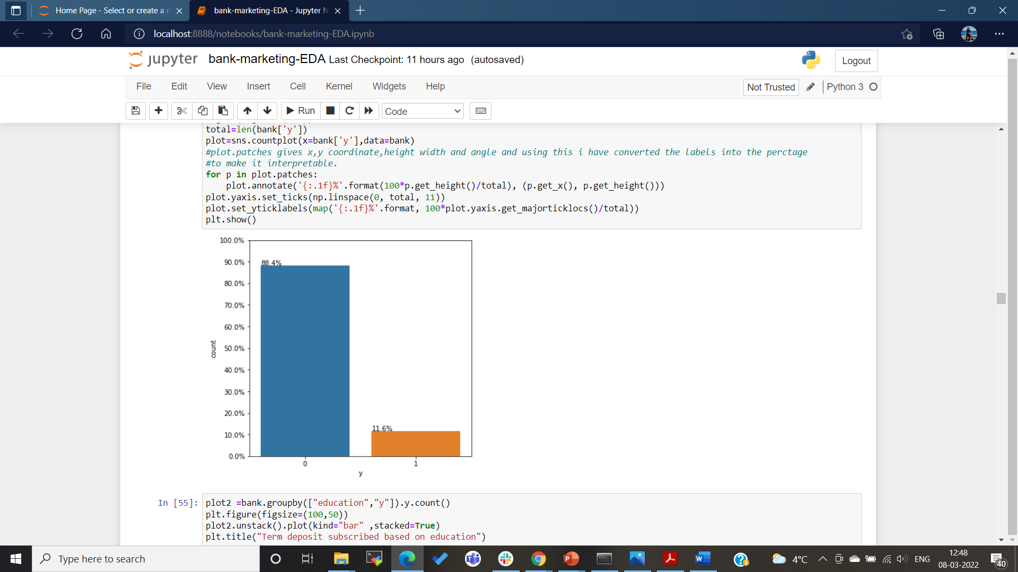
Client subscriptions total count (in %)

Slide 17
Recommended Models
Logistic regression.
Naïve Bayes Classifier.
Gradient Boosting or Gradient Descent Classifier.
Note: Data analysis and data preparation and data modelling and model building (i.e., the above-mentioned models) model selection depends on performance reporting of business models and business perspectives.

